Slide 1
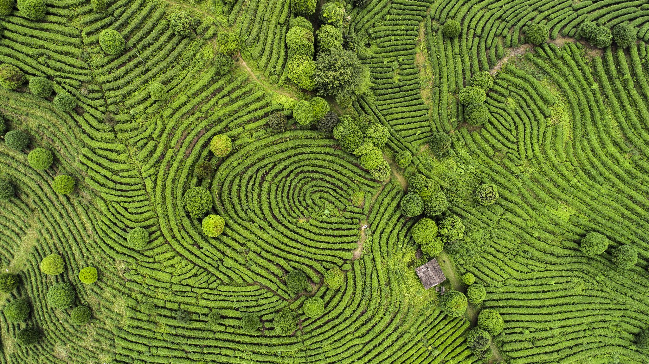
East Asia
Chapter 11

Slide 2
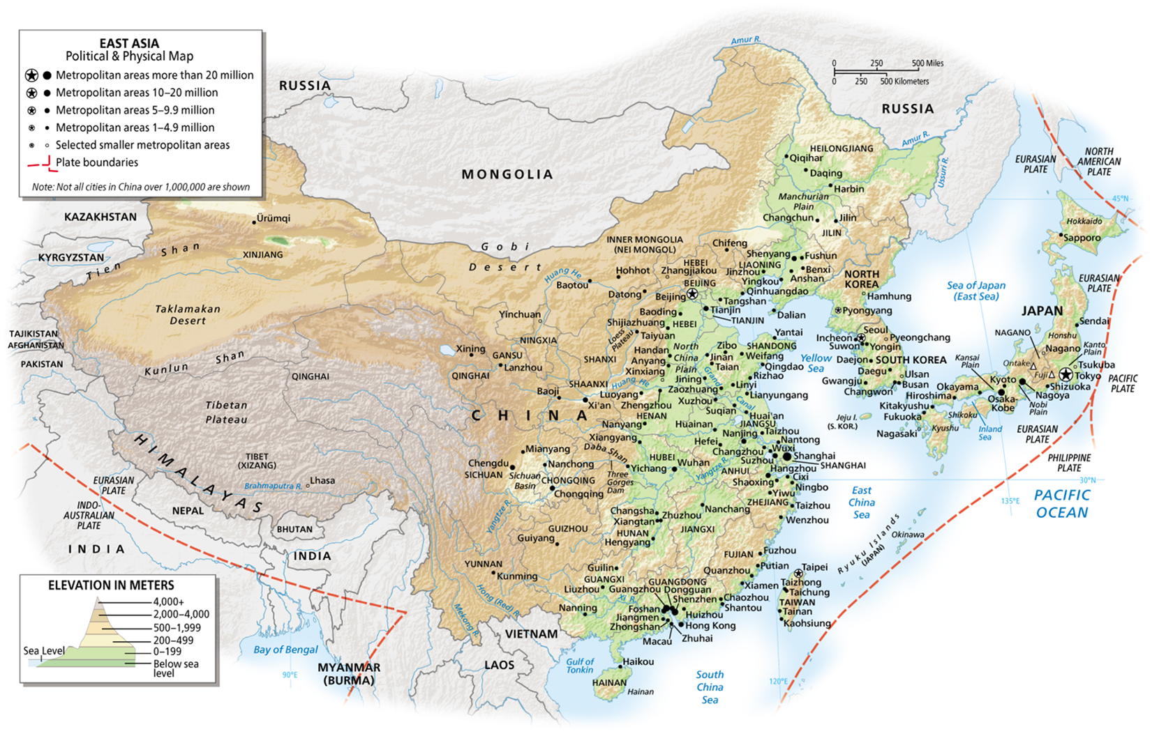
East Asia
The countries of eastern Eurasia were at one time referred to as “the Orient,” from a Latin word meaning “facing the east” or “facing the sunrise.”
This area of about 8 million square miles is more than 2x the size of the United States
More than half of the world's population lives in this region

Slide 3
Area and Population
China, Taiwan, Japan, South Korea, and North Korea
Core area of the world
Advanced economies
Huge population
Historically unified cultural features, politically divided
China’s territorial extent, Taiwan, and Western China

Slide 4
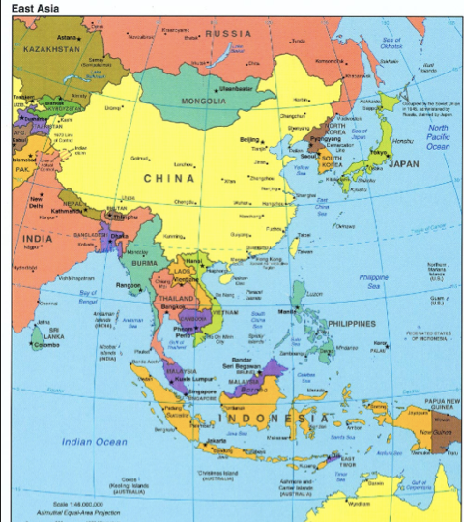
East Asia
China
North and South Korea
Japan
Taiwan

Slide 5
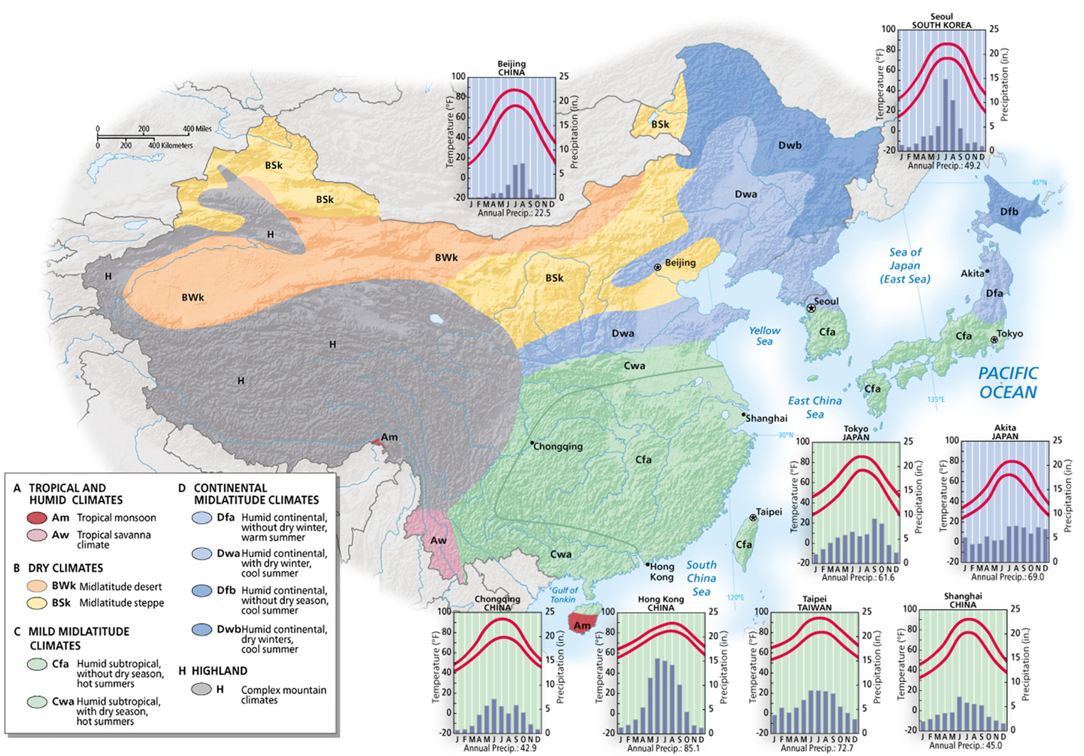
East Asia’s Physical Geography
Same latitudinal range as the United States
Extends farther north and south
The Diverse Environments of China
Two climate areas divided by the Yangtze River
Humid south and north is colder, drier
Desertification
Taiwan mountainous, mostly forested

Slide 6
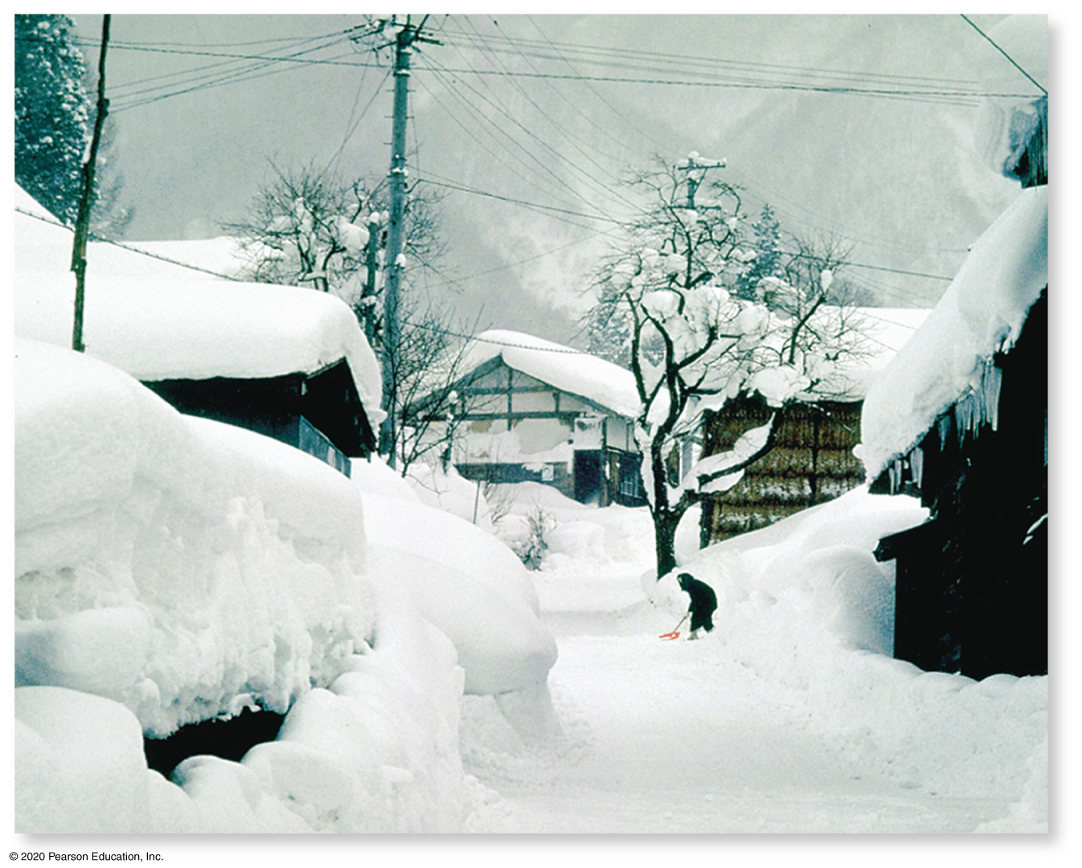
East Asia’s Physical Geography
Japan’s Physical Environment
Temperate seasonality
Extends over wide range of latitude
Mountainous, forested with small alluvial plains
Korean Landscapes
Rugged mountains, sizeable rivers
South has agricultural advantage.
North has raw materials yet deforested

Slide 7
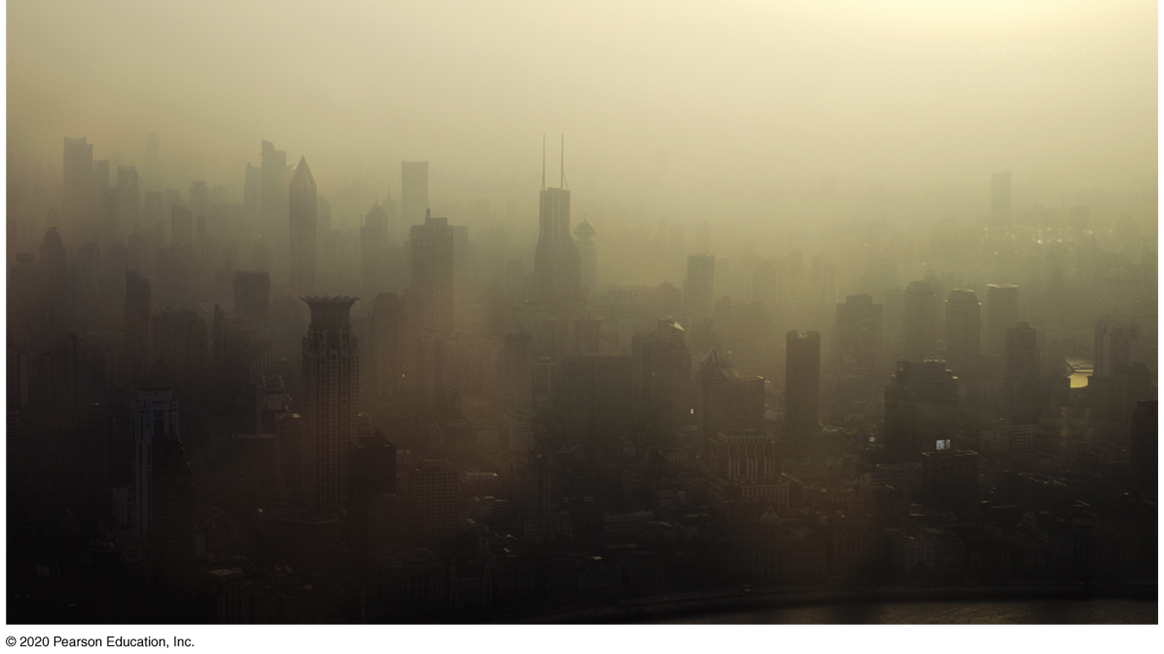
Environmental Issues in East Asia
China has most serious environmental issues
Most severe air and water pollution
Improvements through legislation in Japan, South Korea and Taiwan

Slide 8
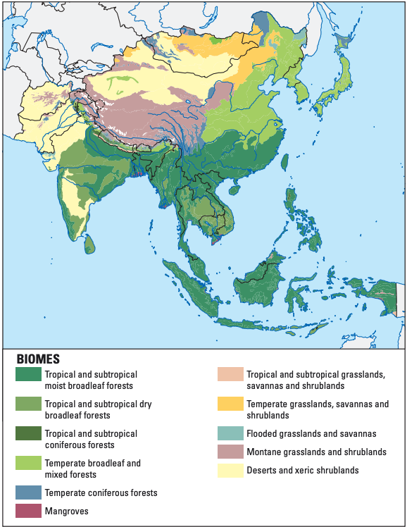
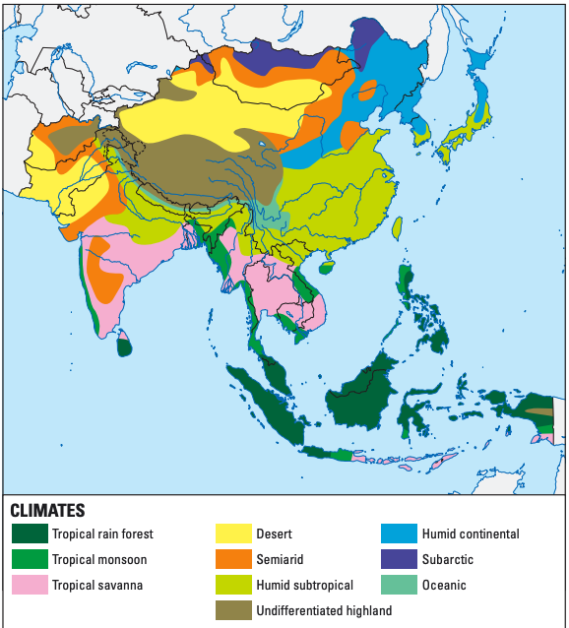
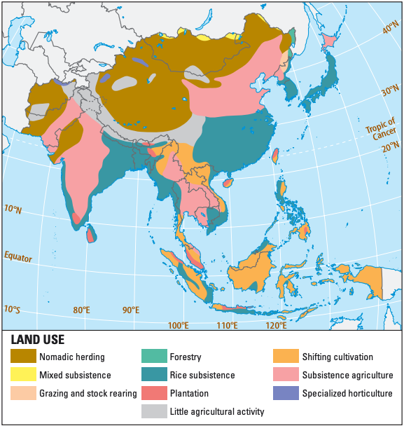
Climate and Vegetation

Slide 9
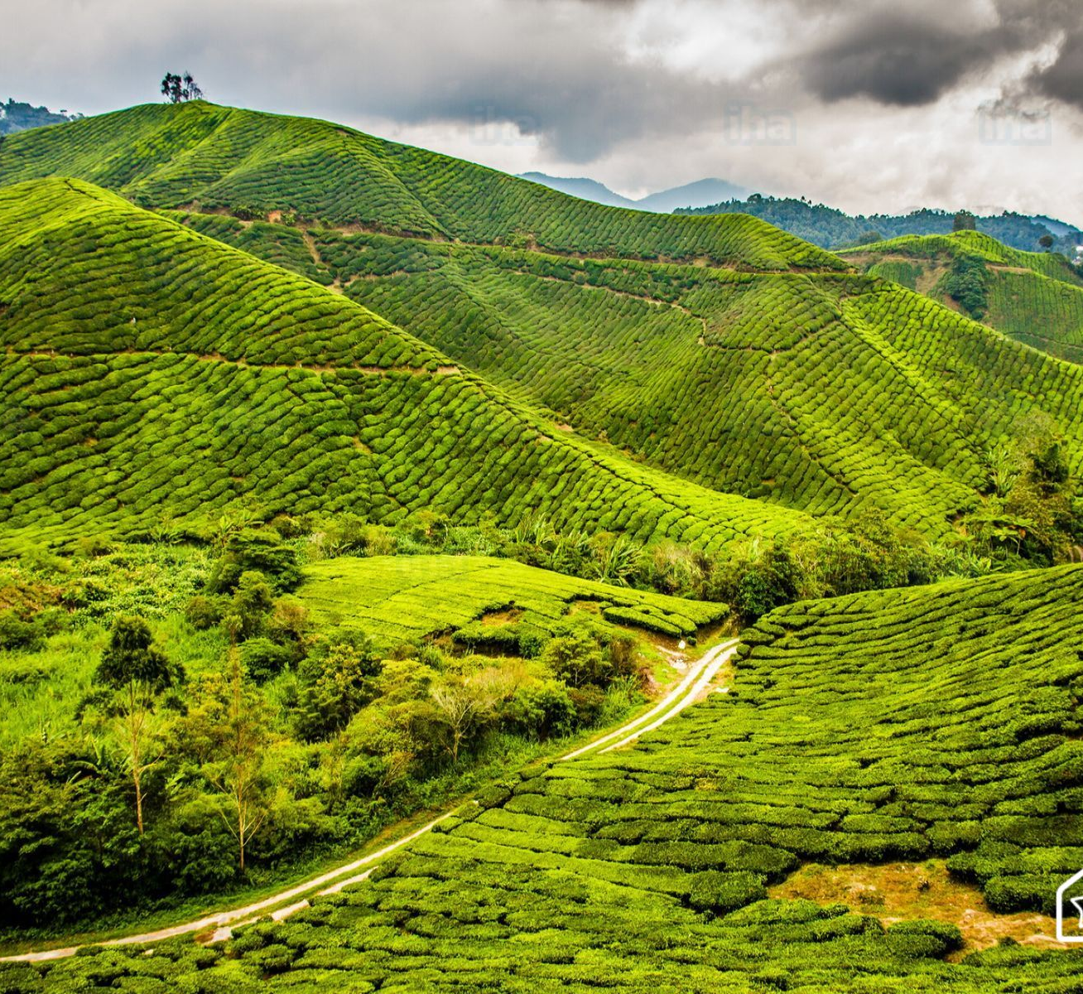
Climate and Vegetation
This region is characterized by warm, and well-watered climates.
Asia’s tropical rainforests are vast, second only to the Amazon Basin in South America in size.
Winters can be quite cold in the north, and the western reaches of the region are very dry deserts
This Photo by Unknown author is licensed under CC BY-SA-NC.

Slide 10
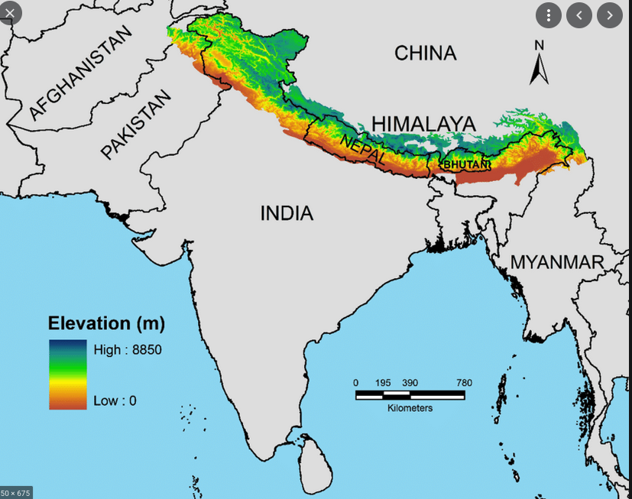
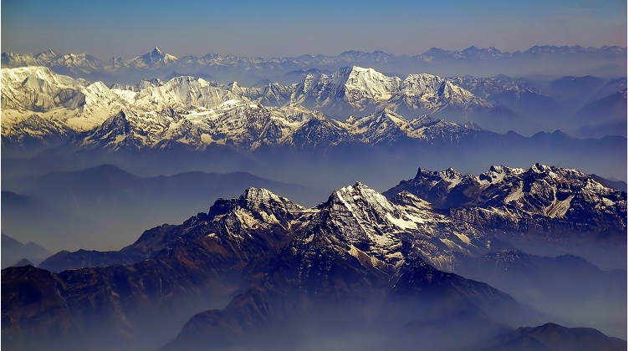
Himalayan Mountains

Slide 11
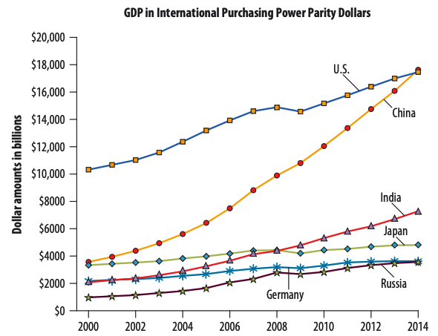
Economic Geography
East Asia is a dynamic region with some of the world’s strongest and fastest-growing economies.
Japan was the first Asian country to develop modern cities and modern types of manufacturing on a large scale.

Slide 12
Cultural and Historical Geographies
East Asia have been home to some of the most important cultural developments of humankind.
From Korea (not Gutenberg’s Germany, as is widely thought) came the first movable printing type.
From China came gunpowder, paper, silk, and china (porcelain).

Slide 13
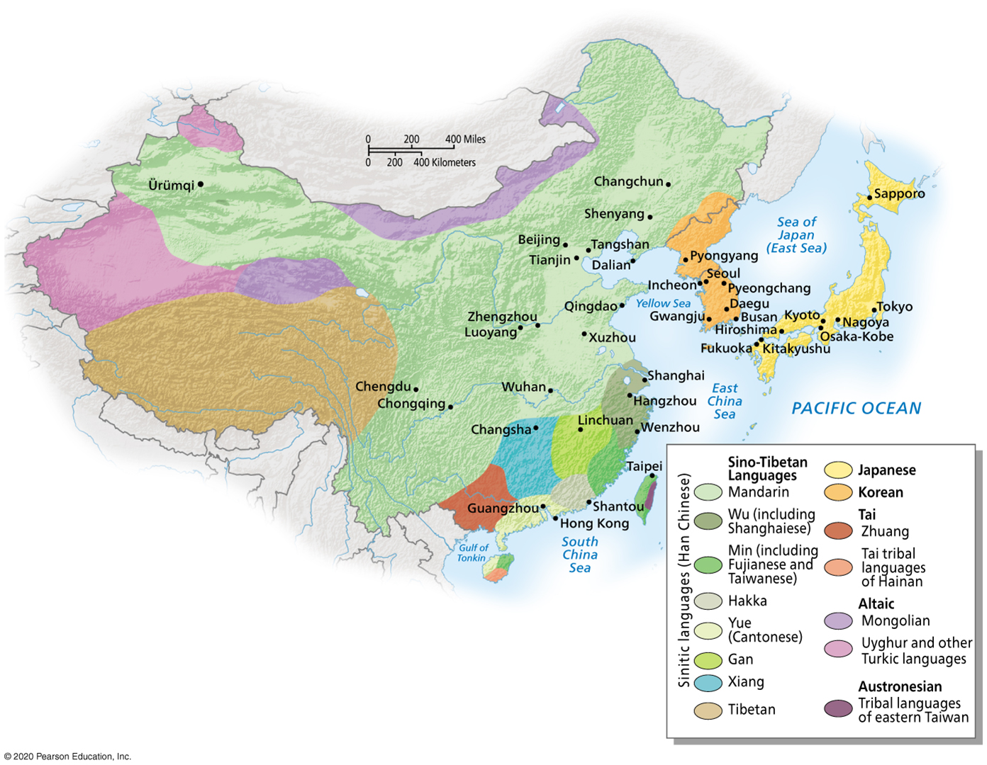
Languages of East Asia

Slide 14
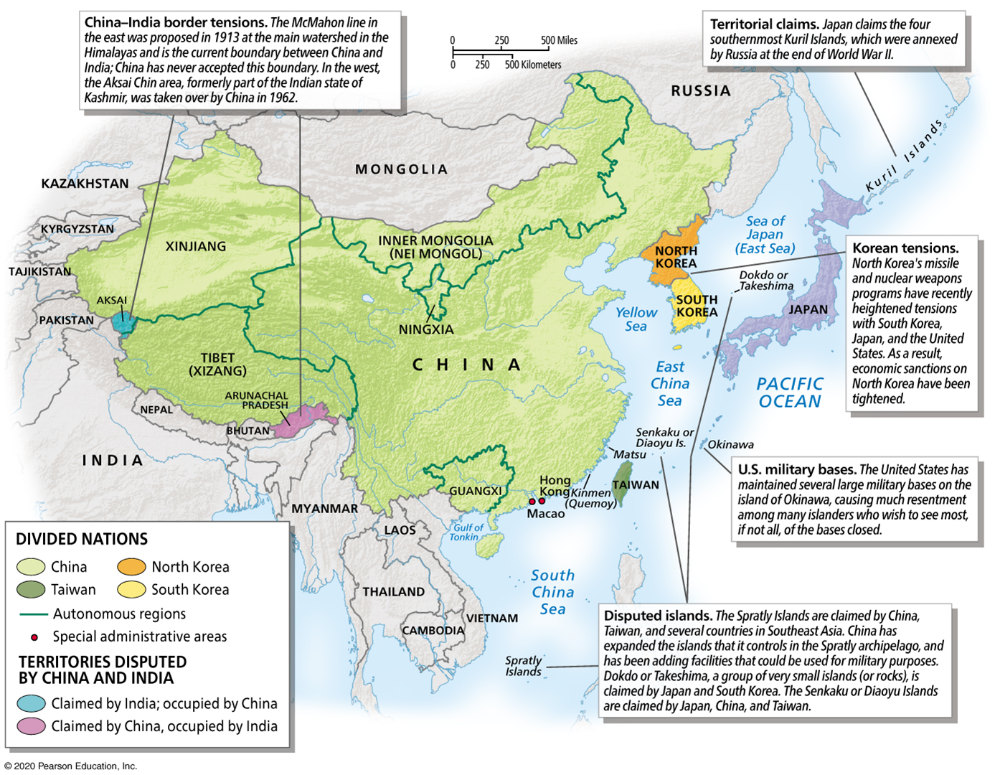
The Imperial Legacies of China and Japan
Political history centered around China and Japan
Chinese Empire to collapse under European aggression
Japan’s ability to remain outside China’s grasp

Slide 15
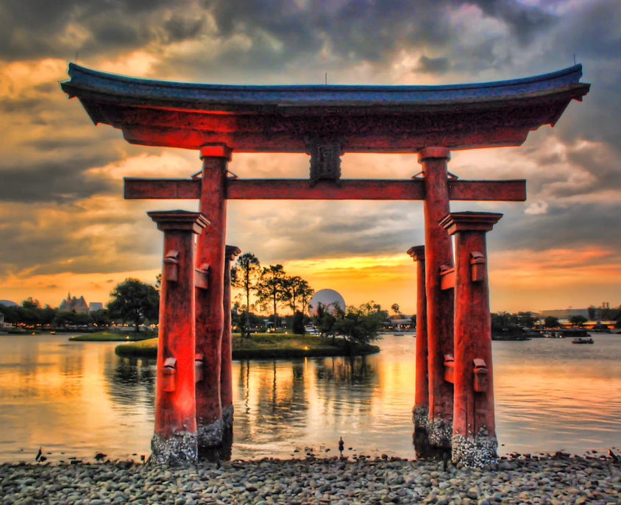
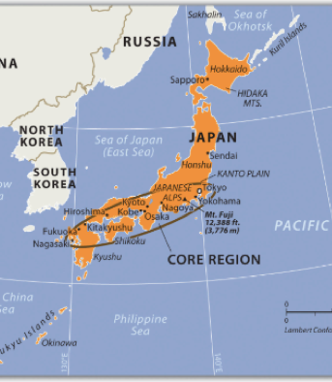
Japan

Slide 16
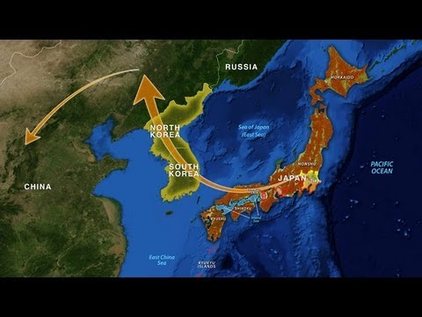

Slide 17
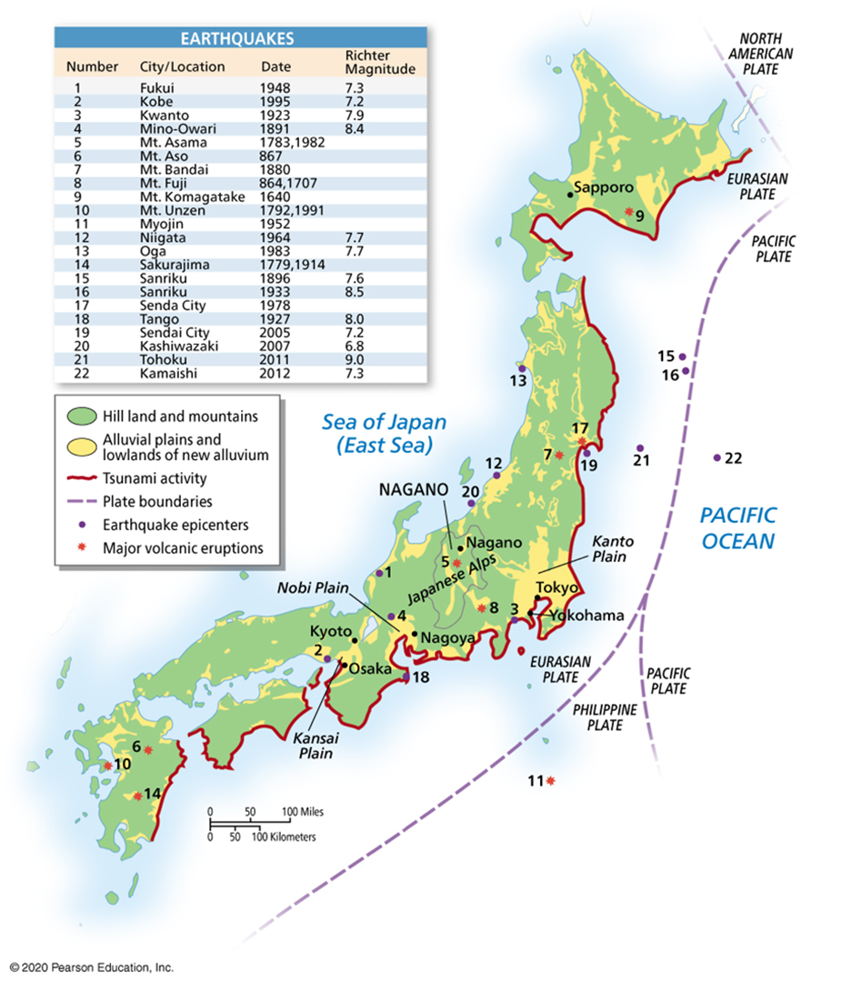
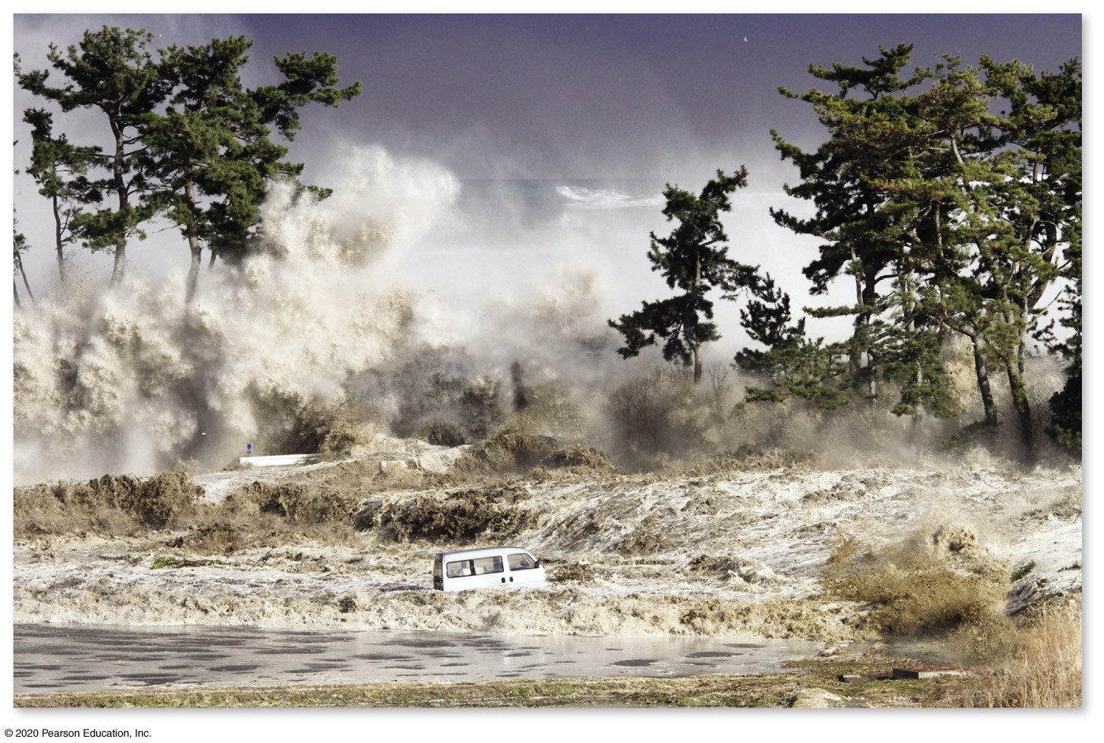
Japan’s Physical Geography
Earthquakes and Tsunamis
Much of region is geologically active, frequent earthquakes
Impacts vary: Japan and China
Japan’s vulnerability to tsunamis

Slide 18
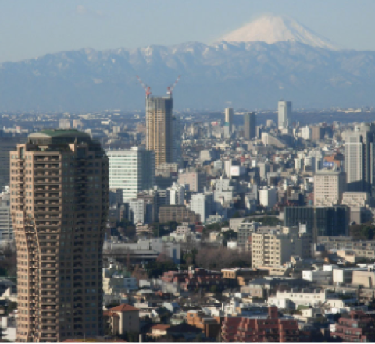
Japan
The mountainous islands of Japan extend into two climate zones.
Most of the population (67 percent) lives in urban areas from Tokyo to Nagasaki.
Tokyo is located where three tectonic plates meet:
Eurasian Plate,
Philippine Plate
Pacific Plate.
Mount Fuji

Slide 19
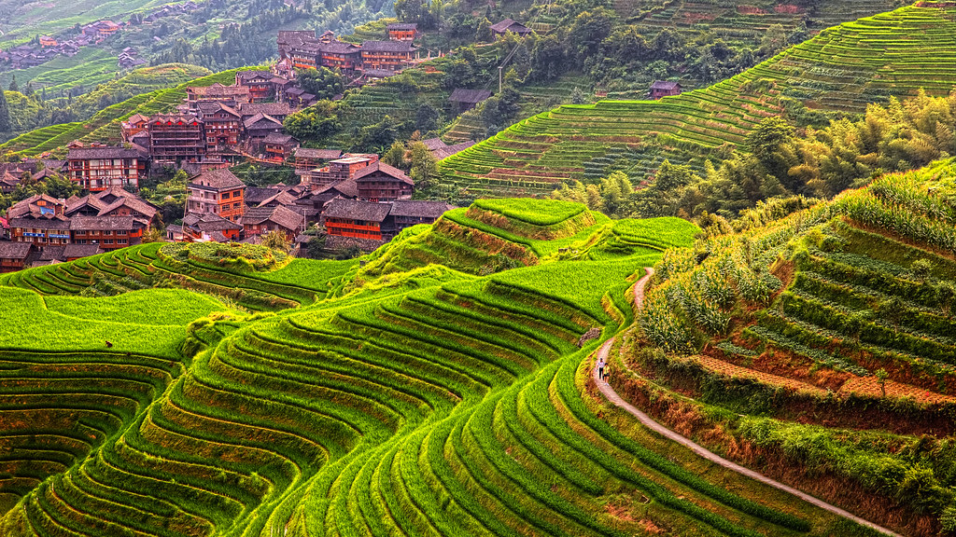
Japan
Human adaptation to Asian lands is wet rice cultivation, capable of producing two or three crops per year and sustaining large populations over long periods of time.
Wet rice agriculture is practiced in both lowland floodplains and on carefully constructed upland terraces.
This Photo by Unknown Author is licensed under CC BY-NC

Slide 20

Tectonic Plate Activity
Tectonic plate activity has been responsible for the existence of the many islands and has created the mountainous terrain of the various countries.
Tectonic activity makes the region vulnerable to earthquakes and volcanic eruptions.

Slide 21
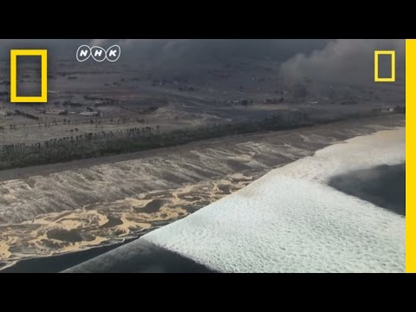
2011 Japanese Earthquake and Tsunami

Slide 22
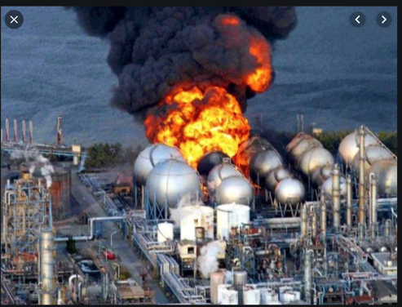
Nuclear Power Disaster - Fukusima
Nuclear power plants along the coast were hit hard by the tsunami, which knocked out their cooling systems and resulted in the meltdown of at least three reactors.
This is considered the worst nuclear accident since the 1986 reactor meltdown at the Soviet plant at Chernobyl, located north of Kiev in present-day Ukraine.

Slide 23
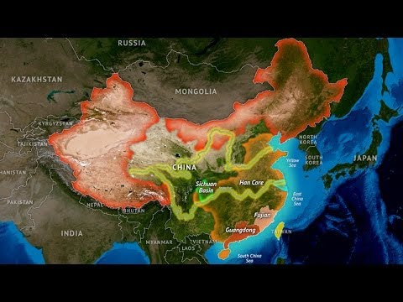
China

Slide 24
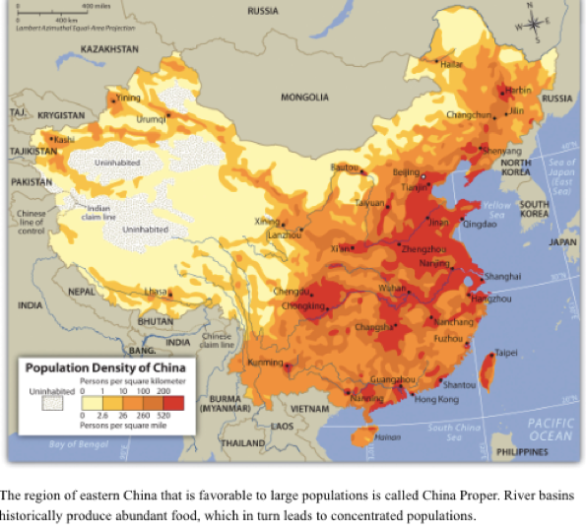
Population Density of China

Slide 25
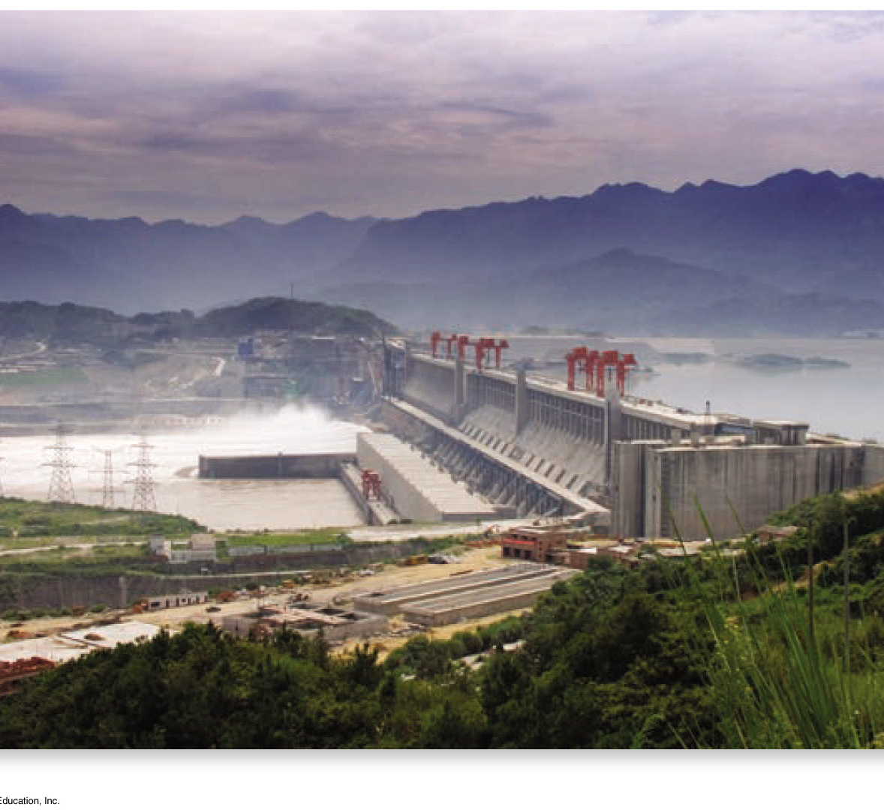
The Three Gorges of the Yangtze
The Three Gorges Controversy
Government wants to prevent flooding and generate electricity
Largest hydroelectric dam completed in 2006
Displaced over 1 million people.

Slide 26
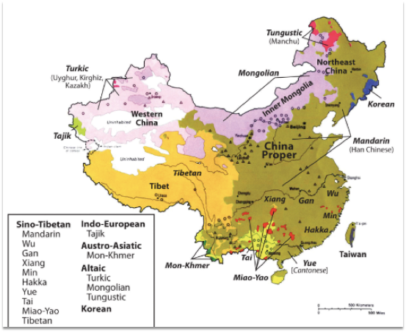
Geopolitics
The core of China is the Han Chinese heartland of China Proper.
The surrounding periphery consists of autonomous regions and minority populations, including Tibet, Western China, Inner Mongolia, and Northwestern China.
Western China has a majority Muslim population closely aligned with ethnic groups in Central Asia.

Slide 27
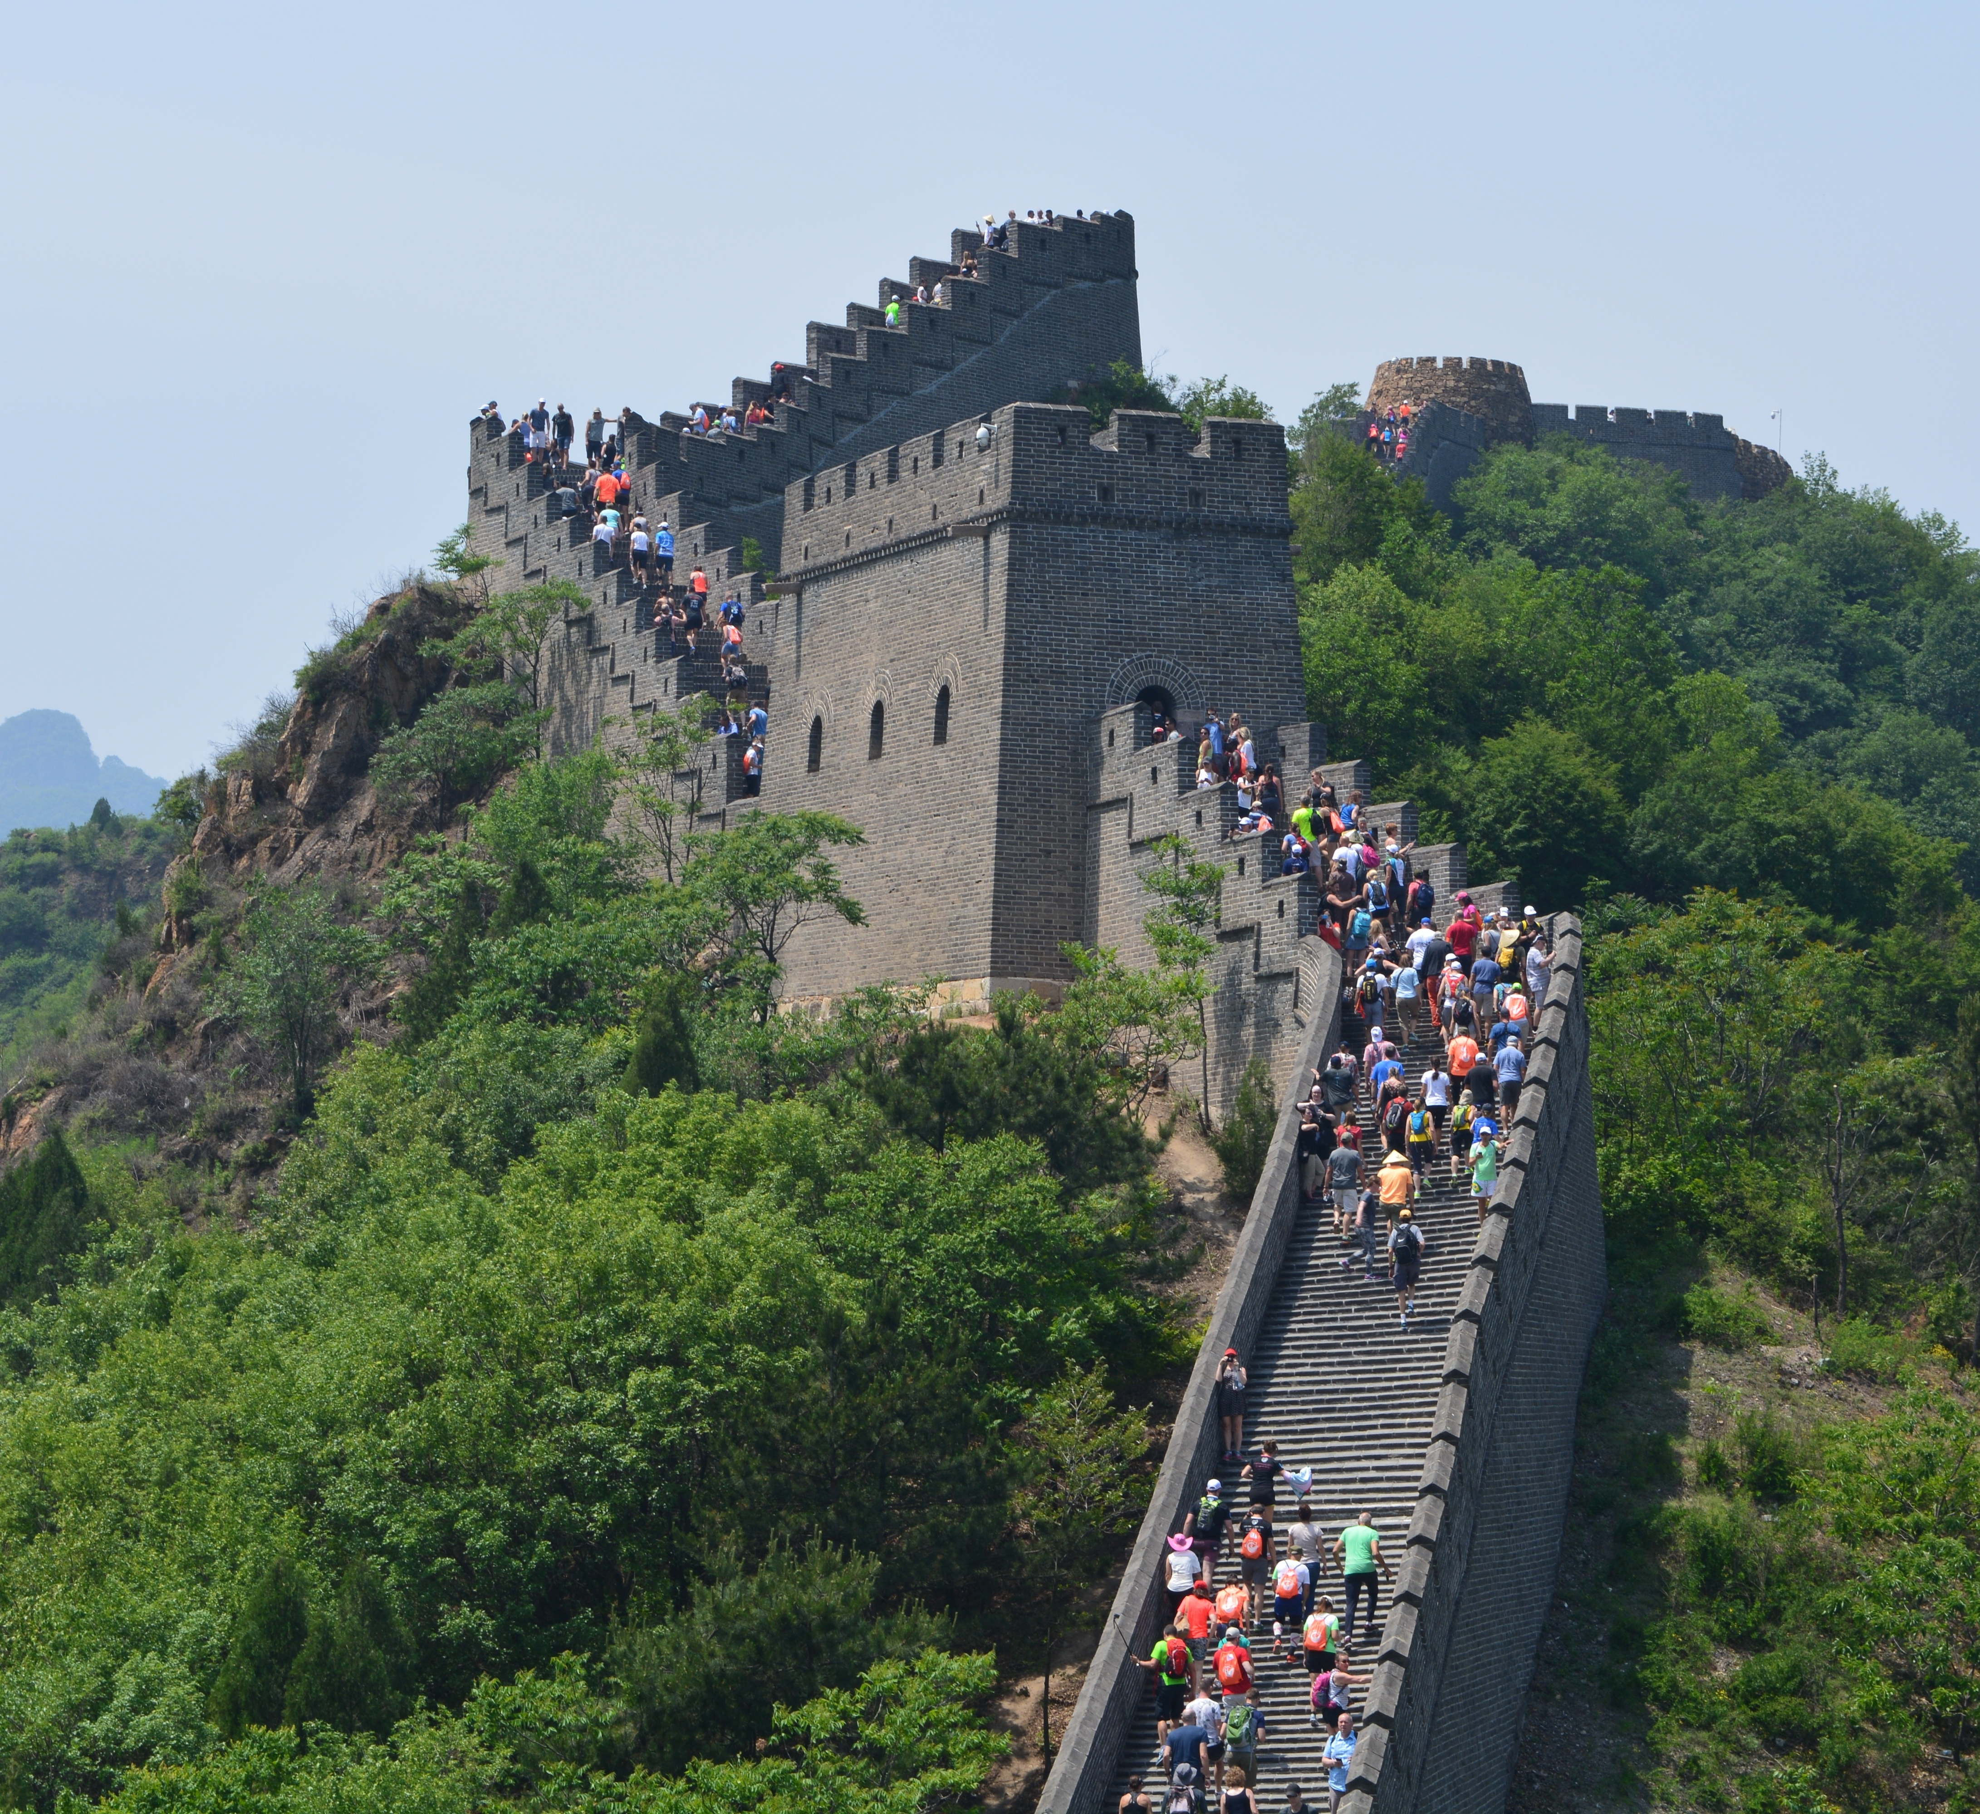
Chinese Dynasties and Colonialism
From 206 to 220 CE, the Han Dynasty established the Chinese identity.
The last dynasty, the Qing (Manchu) Dynasty claimed control of a region including all of China, Mongolia, Southeast Asia, and Korea.
Dynastic rule ended in China in 1911.

Slide 28
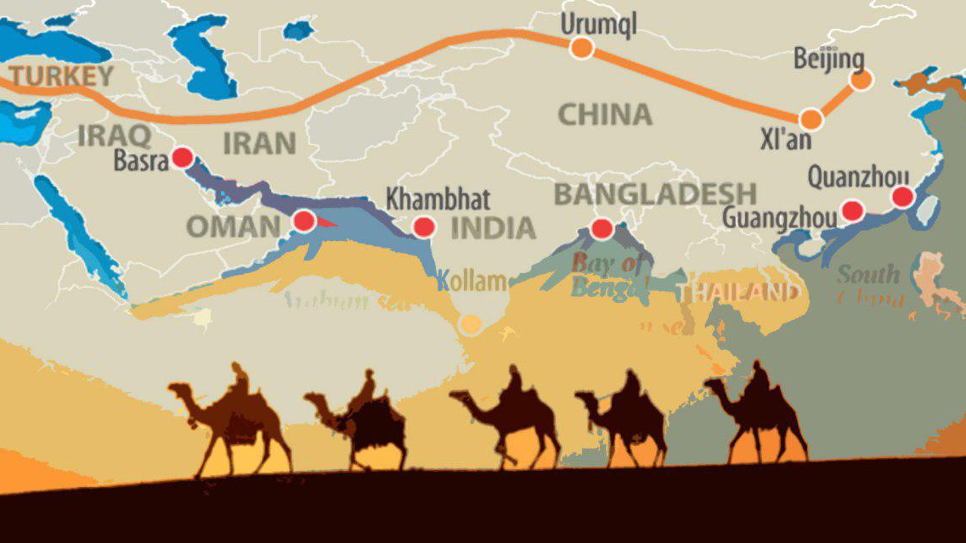
European Colonialism
European colonialism arrived in China during the Qing Dynasty.
China had been an industrialized state for centuries.
The Silk Road which crossed the often dangerous elevations of the high mountain passes, was the main link between China and Europe.
This Photo by Unknown author is licensed under CC BY.

Slide 29
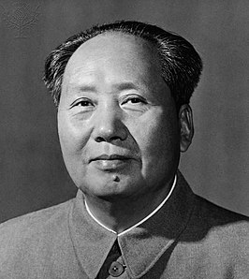
Emergence of Modern China
China is the world’s largest Communist country.
The form of Communism promoted by Mao Zedong was not the same as the type of Communism practiced in the Soviet Union.
About thirty million people lost their lives during the Mao Zedong era through purges, starvation, and conflict.
1992 China transitioned to a socialist market economy.
2000 – China ranked in the top five largest trading nations.
United States, Japan, Germany and France

